Slide 1
CAPABILITY MATURITY MODEL
It is a five-level hierarchical model that is an improvement strategy for building consistent and predictable software products.
It can also be used as a benchmark to assess different organizations for equivalent comparison.
This methodology was designed to help developer’s select process-improvement strategies by determining their current process maturity and identifying the issues most critical to improving their software quality and process.

Slide 2
What is the problem?
One of the major things that led to development of the capability maturity model is that there was rise in many immature software organizations. Good performance attainance is possible but;
Progress is not measured.
Defects are high.
Requirements are often misunderstood.
Schedules and budgets are frequently missed.

Slide 3
Why is CMM crucial?
Increases customer satisfaction.
Helps the organization to determine the current process maturity level in order to increase it.
Helps in identification of few vital problems that the organization should deal with.
Focus is put on a limited set of activities.
Enables steady, continual and lasting gains.

Slide 4
What does it provide?
A starting ground when starting to build software.
The benefit of a community’s prior experiences since it is repeatable.
A framework for prioritizing actions
A way to define what improvement means for your organization.

Slide 5
What are the levels of the capability maturity model?
These are the measurements of improvement.
No. | Maturity Level | Focus | Key process Areas
5. | Optimizing | Continued improvement process. | Change management.
4. | Managed | Product and Process Quality. | Quality management.
3. | Defined | Engineering process and Organizational support. | Product Engineering.
2. | Repeatable | Project management process.
1. | Initial | Competent people and heroic | Competent people and heroics

Slide 6
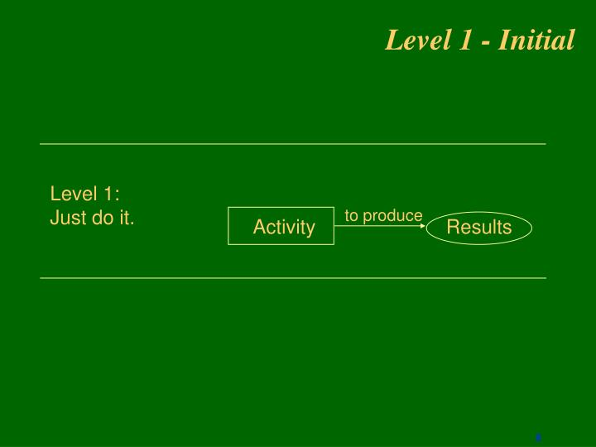
LEVEL 1: INITIAL
You do an activity to produce results.

Slide 7
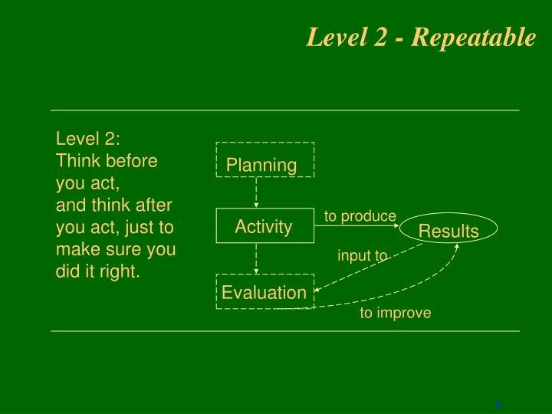
LEVEL 2: REPEATABLE
You first plan then perform an activity to produce results then you evaluate.

Slide 8
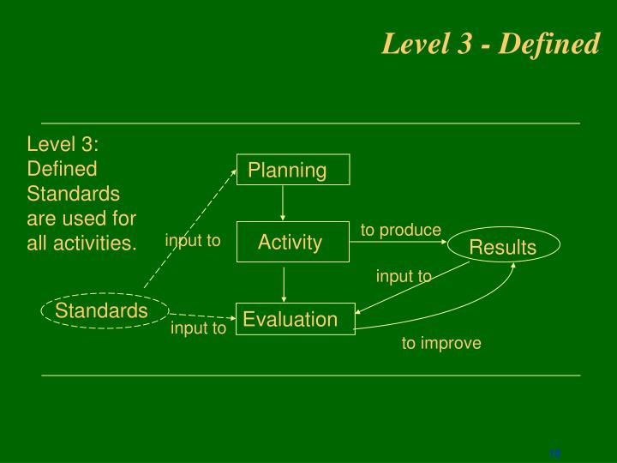
LEVEL 3: DEFINED
Defining standards used for all activities.

Slide 9
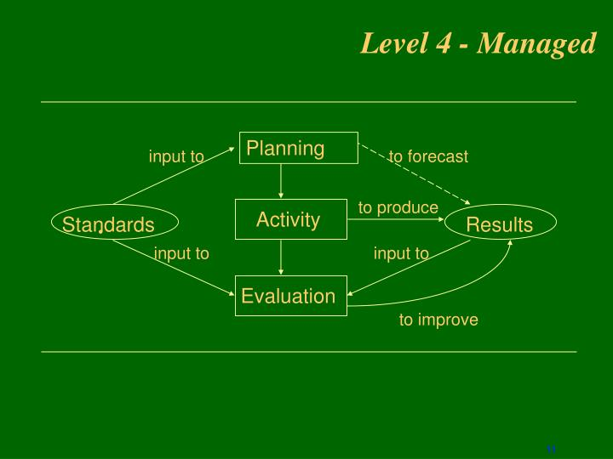
LEVEL 4: MANAGED
The standards are used in the forecasting of events that may occur.

Slide 10
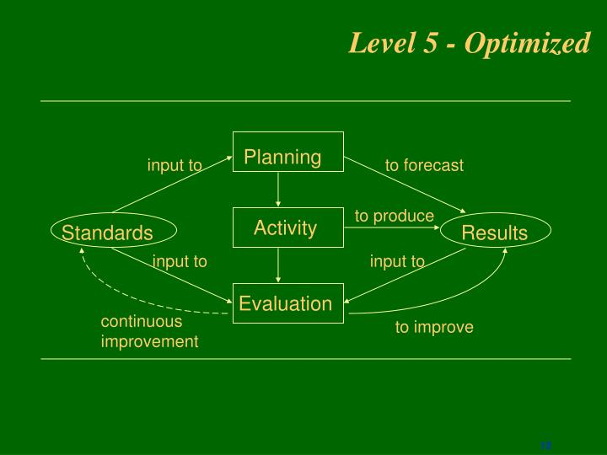
LEVEL 5: OPTIMIZING
Here there is a continuous improvement of the standards.

Slide 11
Can small organizations adopt it?
Yes.
Although small organizations have a mentality of they have competent developer's and they can easily communicate with one another, they experience the same problems that large organization experience. Like:
Having undocumented requirements.
Mistakes of inexperienced managers.
Poor resource allocations.
Poor or no training.

